Slide 1


Chapter 11: Network Address Translation for IPv4
Routing And Switching
Notes:
Cisco Networking Academy program
Routing & Switching
Chapter 11: Network Address Translation for IPv4

Slide 2
NAT Characteristics IPv4 Private Address Space
The IPv4 address space is not big enough to uniquely address all the devices that need to be connected to the Internet
Network private addresses are described in RFC 1918 and are to designed to be used within an organization or site only. Private addresses are not routed by Internet routers while public addresses are
Private addresses can alleviate IPv4 scarcity but since they aren’t routed by Internet devices, they need to be translated first.
NAT is process used to perform such translation
Notes:
11.1 NAT Operation
11.1.1 NAT Characteristics
11.1.1.1 IPv4 Private Address Space

Slide 3
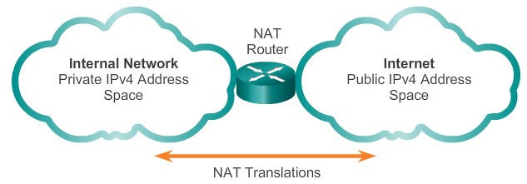
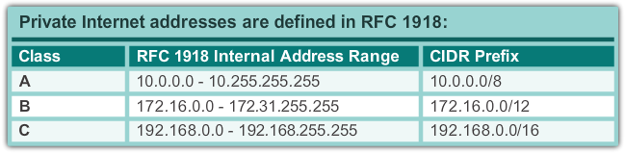
NAT Characteristics IPv4 Private Address Space
Notes:
11.1 NAT Operation
11.1.1 NAT Characteristics
11.1.1.1 IPv4 Private Address Space

Slide 4
NAT Characteristics What is NAT?
NAT is a process used to translate network addresses
NAT’s primary use is to conserve public IPv4 addresses
Usually implemented at border network devices such as firewalls or routers
This allows the networks to use private addresses internally, only translating to public addresses when needed
Devices within the organization can be assigned private addresses and operate with locally unique addresses.
When traffic must be sent/received to/from other organizations or the Internet, the border router translates the addresses to a public and globally unique address
Notes:
11.1 NAT Operation
11.1.1 NAT Characteristics
11.1.1.2 What is NAT?

Slide 5
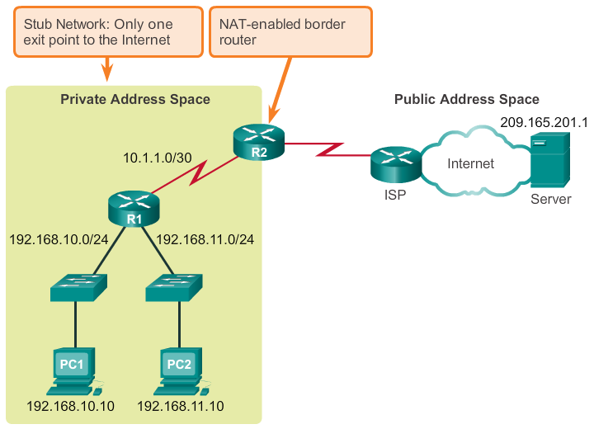
NAT Characteristics What is NAT?
Notes:
11.1 NAT Operation
11.1.1 NAT Characteristics
11.1.1.2 What is NAT?

Slide 6
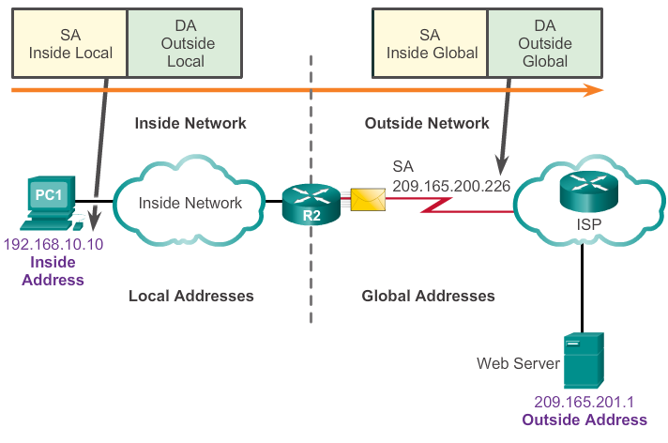
NAT Characteristics NAT Terminology
In NAT terminology, inside network is the set of devices using private addresses. Outside networks are all other networks
NAT includes 4 types of addresses:
Inside local address
Inside global address
Outside local address
Outside global address
Notes:
11.1 NAT Operation
11.1.1 NAT Characteristics
11.1.1.3 NAT Terminology

Slide 7
NAT Characteristics NAT Terminology
Inside local address - The address of the source as seen from inside the network i.e. 192.168.10.10 is assigned to PC1. This is the inside local address of PC1.
Inside global address - The address of source as seen from the outside network. In the figure, when traffic from PC1 is sent to the web server at 209.165.201.1, R2 translates the inside local address to an inside global address. In this case, R2 changes the IPv4 source address from 192.168.10.10 to 209.165.200.226. In NAT terminology, the inside local address of 192.168.10.10 is translated to the inside global address of 209.165.200.226.
Outside global address - The address of the destination as seen from the outside network. It is a globally routable IPv4 address assigned to a host on the Internet. For example, the web server is reachable at IPv4 address 209.165.201.1. Most often the outside local and outside global addresses are the same.
Outside local address - The address of the destination as seen from the inside network. In this example, PC1 sends traffic to the web server at the IPv4 address 209.165.201.1. While uncommon, this address could be different than the globally routable address of the destination.
Notes:
11.1 NAT Operation
11.1.1 NAT Characteristics
11.1.1.3 NAT Terminology

Slide 8
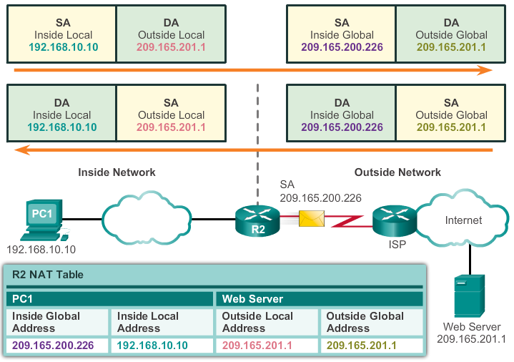
NAT Characteristics How NAT Works
Notes:
11.1 NAT Operation
11.1.1 NAT Characteristics
11.1.1.5 How NAT Works

Slide 9
Types Of NAT
There are three types of NAT translation:
Static address translation (static NAT) - One-to-one address mapping between local and global addresses.
Dynamic address translation (dynamic NAT) - Many-to-many address mapping between local and global addresses.
Port Address Translation (PAT) - Many-to-one address mapping between local and global addresses. This method is also known as overloading (NAT overloading).

Slide 10
Types Of NAT Static NAT
Static NAT uses a one-to-one mapping of local and global addresses
These mappings are configured by the network administrator and remain constant
Static NAT is particularly useful when servers hosted in the inside network must be accessible from the outside network. Particularly useful for web servers or devices that must have a consistent address that is accessible from the Internet
A network administrator can access a server in the inside network by point his client to the proper inside global address.
Static NAT requires that enough public addresses are available to satisfy the total number of simultaneous user sessions.
Notes:
11.1 NAT Operation
11.1.2 Types Of NAT
11.1.2.1 Static NAT

Slide 11
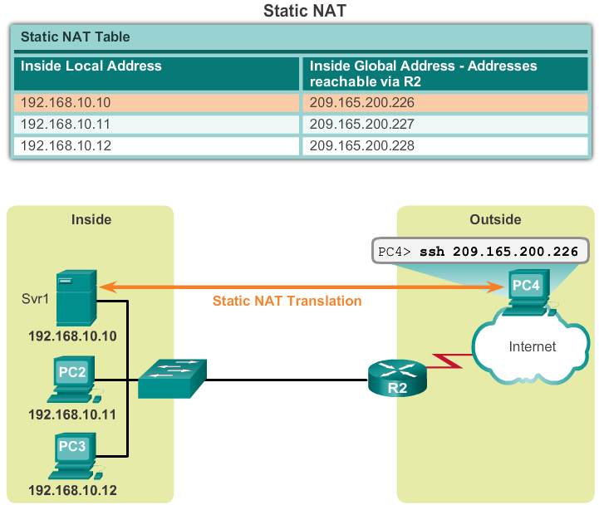
Types Of NAT Static NAT
Notes:
11.1 NAT Operation
11.1.2 Types Of NAT
11.1.2.1 Static NAT

Slide 12
Types Of NAT Dynamic NAT
Dynamic NAT uses a pool of public addresses and assigns them on a first-come, first-served basis
When an inside device requests access to an outside network, dynamic NAT assigns an available public IPv4 address from the pool
Dynamic NAT requires that enough public addresses are available to satisfy the total number of simultaneous user sessions
Notes:
11.1 NAT Operation
11.1.2 Types Of NAT
11.1.2.2 Dynamic NAT

Slide 13
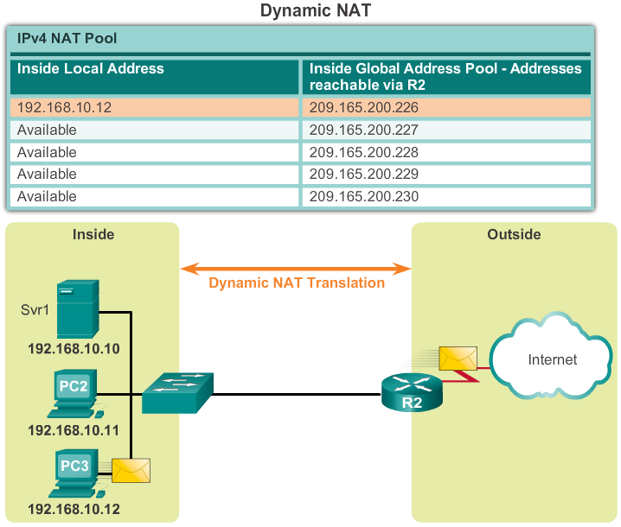
Types Of NAT Dynamic NAT
Notes:
11.1 NAT Operation
11.1.2 Types Of NAT
11.1.2.2 Dynamic NAT

Slide 14
Types Of NAT Port Address Translation NAT (PAT)
PAT maps multiple private IPv4 addresses to a single public IPv4 address or a few addresses
PAT uses the pair source port and source IP address to keep track of what traffic belongs to what internal client
PAT is also known as NAT overload
By also using the port number, PAT is able to forward the response packets to the correct internal device
The PAT process also validates that the incoming packets were requested, thus adding a degree of security to the session
Notes:
11.1 NAT Operation
11.1.2 Types Of NAT
11.1.2.3 Port Address Translation NAT (PAT)

Slide 15
Types Of NAT Comparing (Dynamic) NAT and PAT
(Dynamic) NAT translates IPv4 addresses on a 1:1 basis between private IPv4 addresses and public IPv4 addresses
PAT modifies both the address and the port number
(Dynamic) NAT forwards incoming packets to their inside destination by referring to the incoming source IPv4 address given by the host on the public network
With PAT, there is generally only one or a very few publicly exposed IPv4 addresses
PAT is also able to translate protocols that don’t use port numbers such as ICMP. Each one of these protocols are supported differently by PAT
Notes:
11.1 NAT Operation
11.1.2 Types Of NAT
11.1.2.5 Comparing NAT and PAT

Slide 16
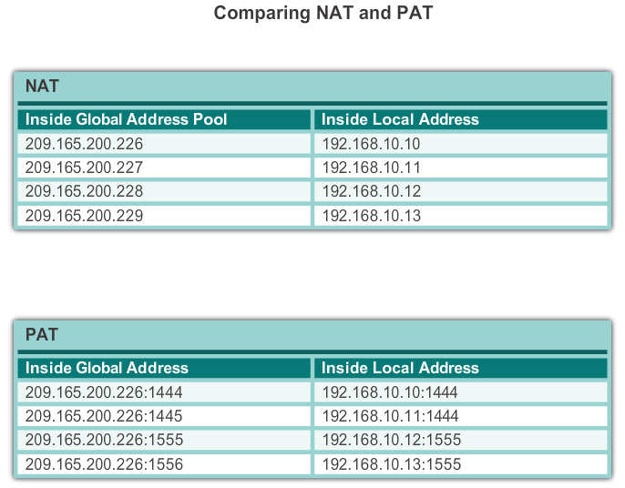
Types Of NAT Comparing (Dynamic) NAT and PAT
NAT translates IPv4 addresses on a 1:1 basis between private IPv4 addresses and public IPv4 addresses. However, PAT modifies both the address and the port number.
4 Public
Addresses
1 Public
Addresses

Slide 17
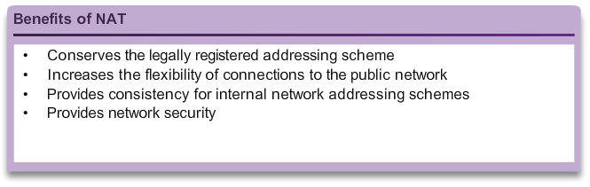
Benefits Of NAT Benefits of NAT
Notes:
11.1 NAT Operation
11.1.3 Benefits Of NAT
11.1.3.1 Benefits Of NAT

Slide 18
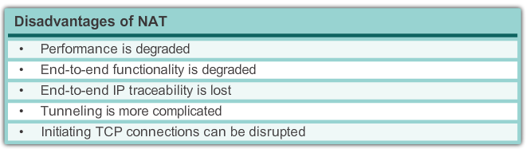
Benefits Of NAT Disadvantages of NAT
Notes:
11.1 NAT Operation
11.1.3 Benefits Of NAT
11.1.3.2 Disadvantages of NAT

Slide 19
Configuring Static NAT Configuring Static NAT
There are two basic tasks when configuring static NAT translations:
Create the mapping between the inside local and outside local addresses
Define which interface belong to the inside network and which belong to the outside network
Notes:
11.1 NAT Operation
11.2.1 Configuring Static NAT
11.2.1.1 Configuring Static NAT

Slide 20
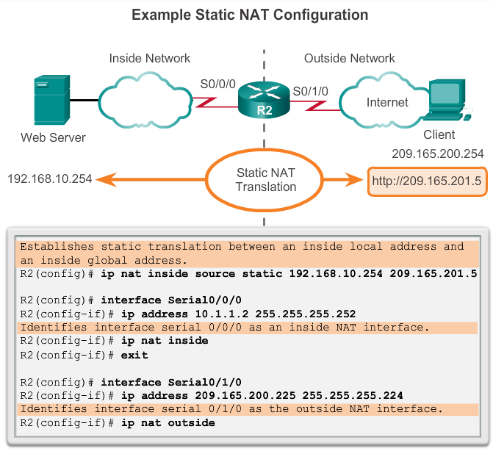
Configuring Static NAT Configuring Static NAT
Shows the commands needed on R2 to create a static NAT mapping to the web server in the example topology.
With the configuration shown, R2 translates packets from the web server with address 192.168.10.254 to public IPv4 address 209.165.201.5.
The Internet client directs web requests to the public IPv4 address 209.165.201.5. R2 forwards that traffic to the web server at 192.168.10.254.
Notes:
11.1 NAT Operation
11.2.1 Configuring Static NAT
11.2.1.1 Configuring Static NAT

Slide 21
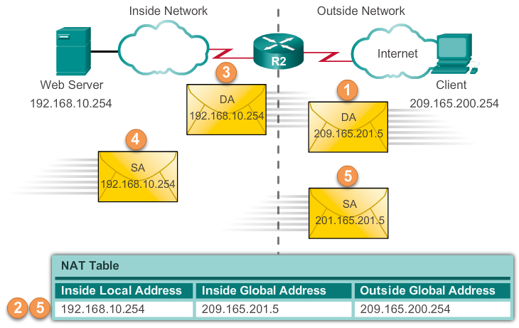
Configuring Static NAT Analyzing Static NAT
The client wants to open a connection to the web server. The client sends a packet to the web server using the public IPv4 destination address of 209.165.201.5
Notes:
11.1 NAT Operation
11.2.1 Configuring Static NAT
11.2.1.2 Analyzing Static NAT

Slide 22
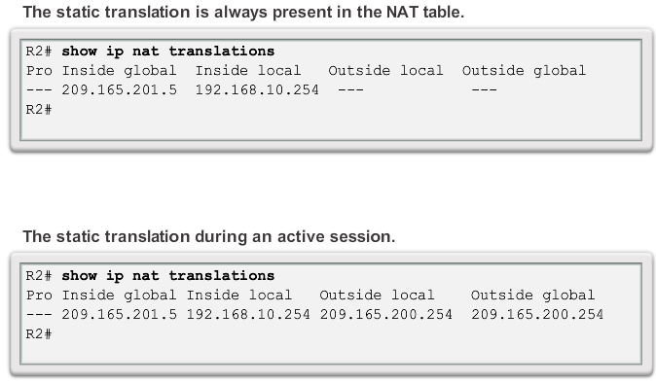
Configuring Static NAT Verifying Static NAT
Notes:
11.1 NAT Operation
11.2.1 Configuring Static NAT
11.2.1.2 Verifying Static NAT

Slide 23
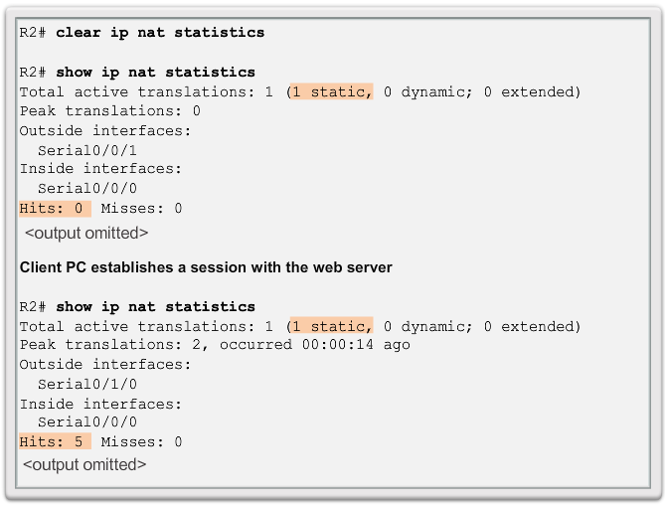
Configuring Static NAT Verifying Static NAT
To verify that the NAT translation is working, it is best to clear statistics from any past translations using the clear ip nat statistics command before testing.
Prior to any communications with the web server, the show ip nat statistics command shows no current hits.
After the client establishes a session with the web server, the show ip nat statistics command has been incremented to five hits. This verifies that the static NAT translation is taking place on R2.
Notes:
11.1 NAT Operation
11.2.1 Configuring Static NAT
11.2.1.2 Verifying Static NAT

Slide 24
Configuring Dynamic NAT Dynamic NAT Operation
The pool of public IPv4 addresses (inside global address pool) is available to any device on the inside network on a first-come first-served basis
With dynamic NAT, a single inside address is translated to a single outside address
The pool must be large enough to accommodate all inside devices
A device won’t be able to communicate to any external networks if no addresses are available in the pool
Notes:
11.1 NAT Operation
11.2.2 Configuring Dynamic NAT
11.2.2.1 Dynamic NAT Operation

Slide 25
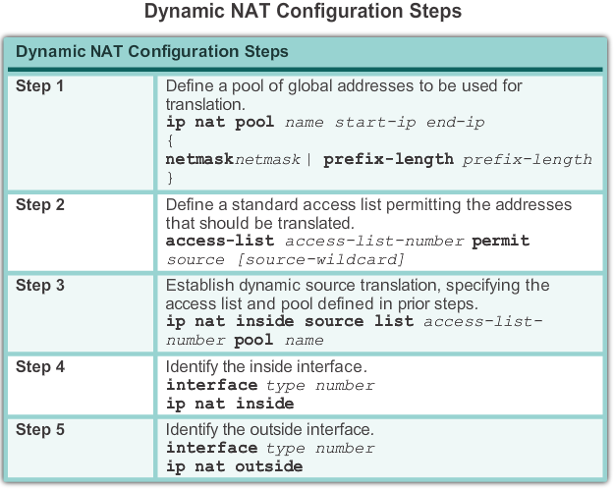
Configuring Dynamic NAT Configuring Dynamic NAT
Notes:
11.1 NAT Operation
11.2.2 Configuring Dynamic NAT
11.2.2.2 Configuring Dynamic NAT

Slide 26
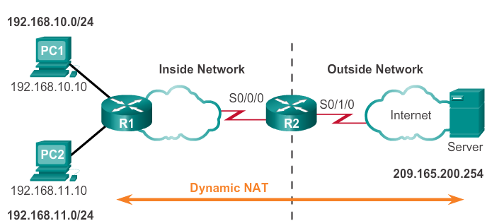
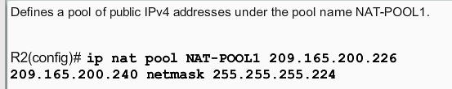
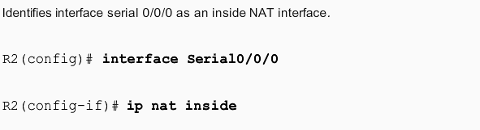
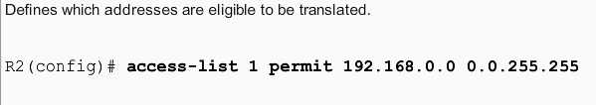
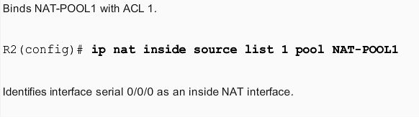
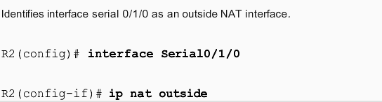
Configuring Dynamic NAT

Slide 27
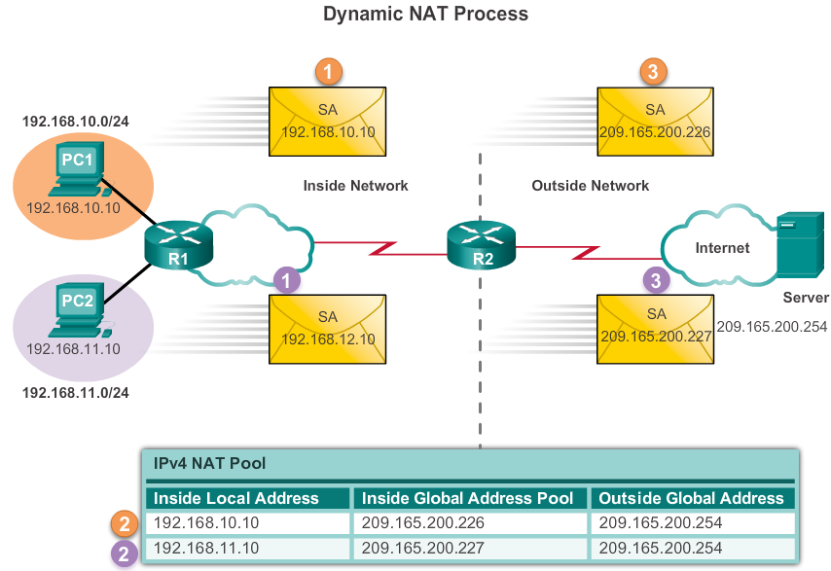
Configuring Dynamic NAT Analyzing Dynamic NAT
Notes:
11.1 NAT Operation
11.2.2 Configuring Dynamic NAT
11.2.2.3 Analyzing Dynamic NAT

Slide 28
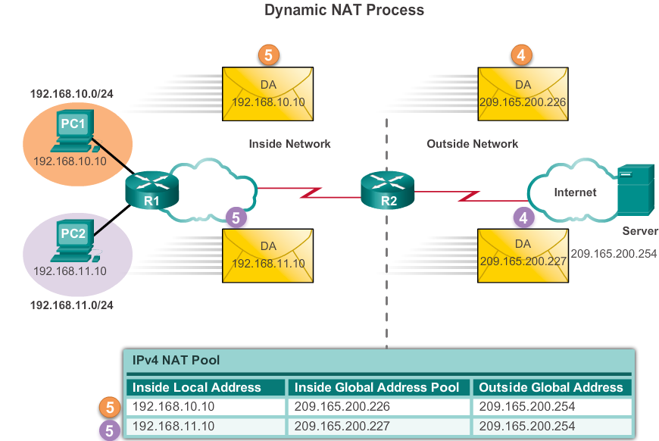
Configuring Dynamic NAT Analyzing Dynamic NAT
Notes:
11.1 NAT Operation
11.2.2 Configuring Dynamic NAT
11.2.2.3 Analyzing Dynamic NAT

Slide 29
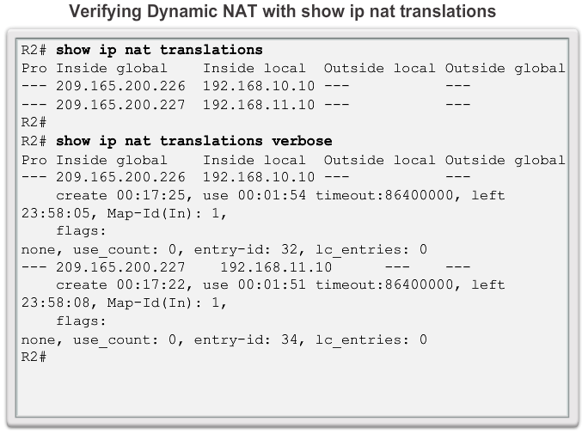
Configuring Dynamic NAT Verifying Dynamic NAT
Notes:
11.1 NAT Operation
11.2.2 Configuring Dynamic NAT
11.2.2.4 Verifying Dynamic NAT

Slide 30
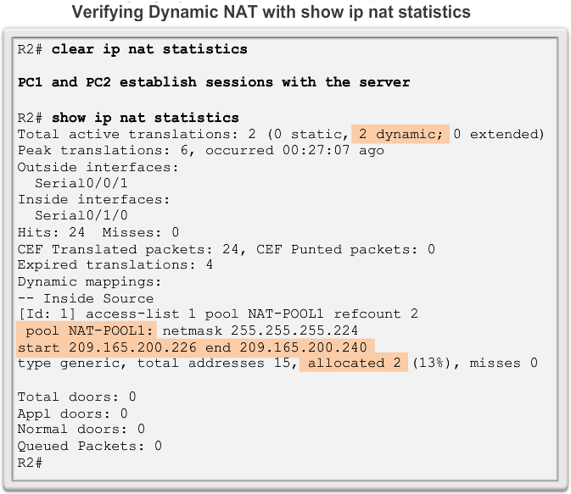
Configuring Dynamic NAT Verifying Dynamic NAT
Notes:
11.1 NAT Operation
11.2.2 Configuring Dynamic NAT
11.2.2.4 Verifying Dynamic NAT

Slide 31
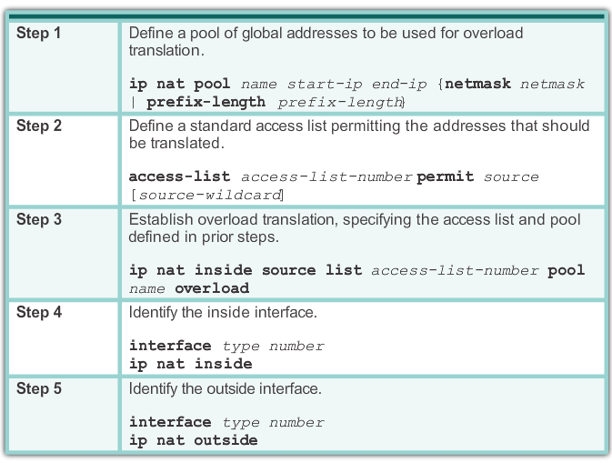
Configuring Port Address Translation (PAT) Configuring PAT: Pool of Addresses
PAT (also called NAT overload) conserves addresses in the inside global address pool by allowing the router to use one inside global address for many inside local addresses. In other words, a single public IPv4 address can be used for hundreds, even thousands of internal private IPv4 addresses
Notes:
11.1 NAT Operation
11.2.3 Configuring Port Address Translation (PAT)
11.2.3.2 Configuring PAT: Single Address

Slide 32
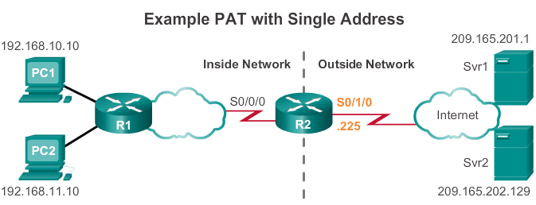
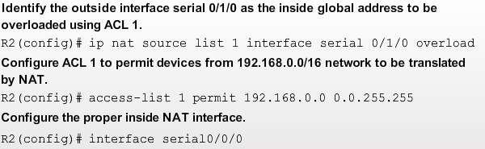
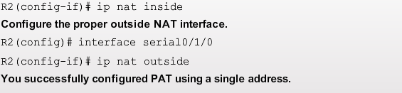
Configuring PAT for a Single Public IP Address

Slide 33
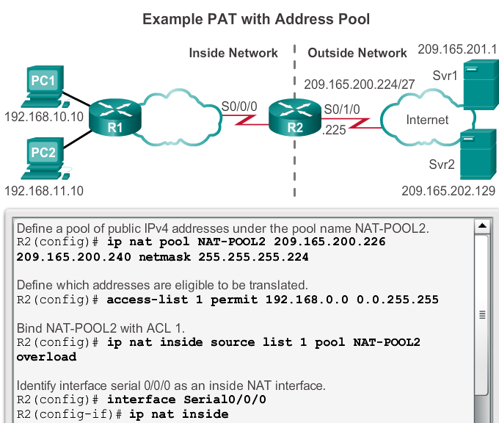

Configuring PAT for a Pool of Public IP Addresses
NAT-POOL2 contains addresses 209.165.200.226 to 209.165.200.240

Slide 34
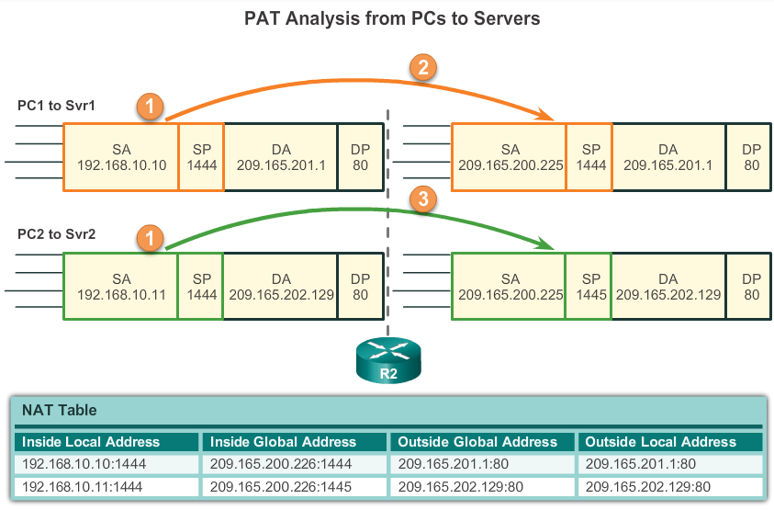
Configuring Port Address Translation (PAT) Analyzing PAT
Notes:
11.1 NAT Operation
11.2.3 Configuring Port Address Translation (PAT)
11.2.3.3 Analyzing PAT

Slide 35
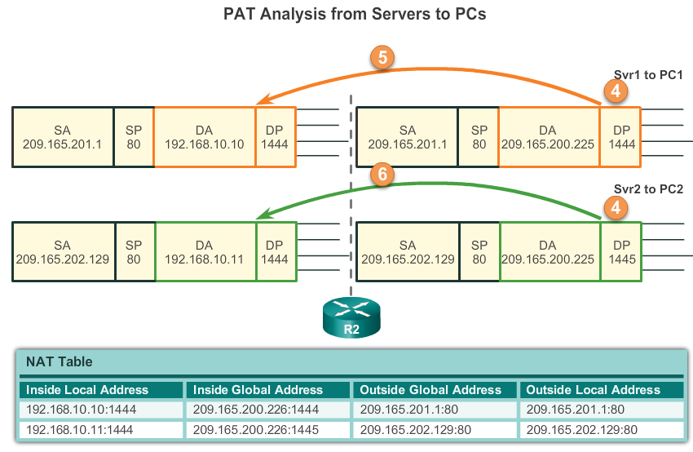
Configuring Port Address Translation (PAT) Analyzing PAT
Notes:
11.1 NAT Operation
11.2.3 Configuring Port Address Translation (PAT)
11.2.3.3 Analyzing PAT

Slide 36
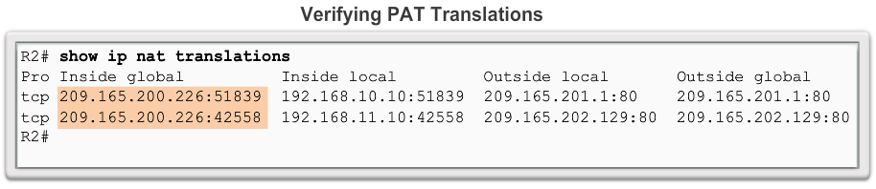
Configuring Port Address Translation (PAT) Verifying PAT
Notes:
11.1 NAT Operation
11.2.3 Configuring Port Address Translation (PAT)
11.2.3.4 Verifying PAT

Slide 37
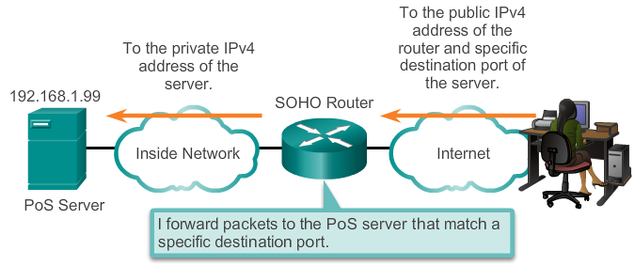
Port Forwarding Port Forwarding
Port forwarding is the act of forwarding a network port from one network node to another
The problem is that NAT does not allow requests initiated from the outside. This situation can be resolved with manual intervention. Port forwarding can be configured to identify specific ports that can be forwarded to inside hosts
A packet sent to the public IP address and port of a router can be forwarded to a private IP address and port in inside network
This is helpful in situations where servers have private addresses, not reachable from the outside networks
Notes:
11.1 NAT Operation
11.2.4 Port Forwarding
11.2.4.1 Port Forwarding

Slide 38
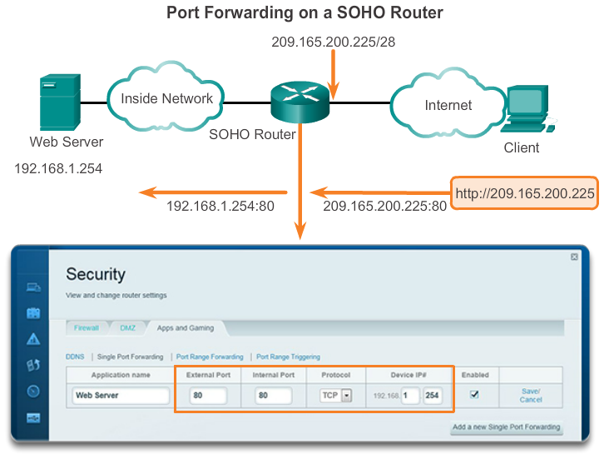
Port Forwarding SOHO (Small Office / Home Office) Example
Notes:
11.1 NAT Operation
11.2.4 Port Forwarding
11.2.4.2 SOHO Example

Slide 39
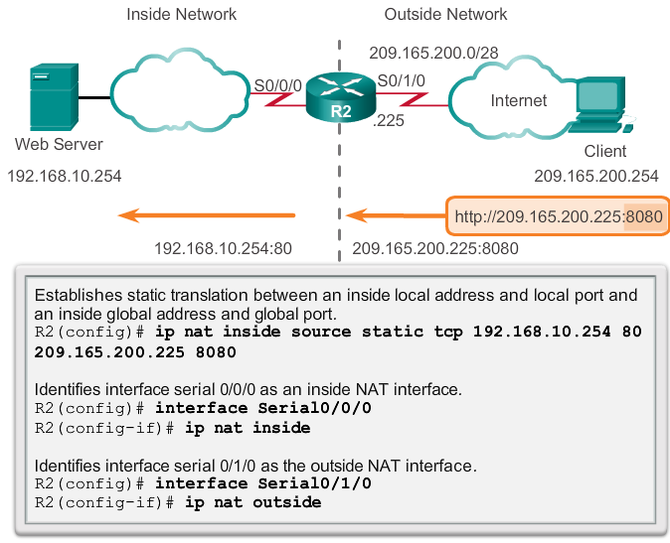
Port Forwarding Configuring Port Forwarding with IOS
Implementing port forwarding with IOS commands is similar to the commands used to configure static NAT.
Port forwarding is essentially a static NAT translation with a specified TCP or UDP port number.In IOS, Port forwarding is essentially a static NAT translation with a specified TCP or UDP port number
Notes:
11.1 NAT Operation
11.2.4 Port Forwarding
11.2.4.3 Configuring Port Forwarding with IOS

Slide 40
Configuring NAT and IPv6 NAT for IPv6?
NAT is a workaround for IPv4 address scarcity
IPv6 with a 128-bit address provides 340 undecillion addresses
Address space is not an issue for IPv6
IPv6 makes IPv4 public-private NAT unnecessary by design
However, IPv6 does implement a form of private addresses and it is implemented differently than they are for IPv4
Notes:
11.1 NAT Operation
11.2.5 Configuring NAT and IPv6
11.2.5.1 NAT for IPv6?

Slide 41
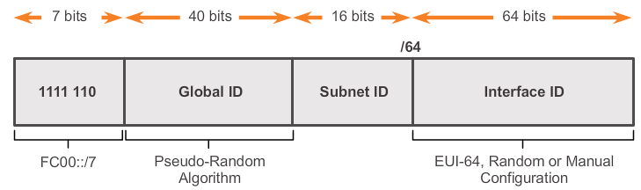
Configuring NAT and IPv6 IPv6 Unique Local Addresses
IPv6 unique local addresses (ULA) is designed to allows IPv6 communications within a local site
ULA is not meant to provide additional IPv6 address space
ULA have the prefix FC00::/7, which results in a first hextet range of FC00 to FDFF
Unique local addresses are defined in RFC 4193
ULAs is also known as local IPv6 addresses (not to be confused with IPv6 link-local addresses)
Notes:
11.1 NAT Operation
11.2.5 Configuring NAT and IPv6
11.2.5.2 IPv6 Unique Local Addresses

Slide 42
Configuring NAT and IPv6 NAT For IPv6
IPv6 also uses NAT but in a much different context
In IPv6, NAT is used to provide transparent communication between IPv6 and IPv4
NAT64 is not intended to be a permanent solution. It is meant to be a transition mechanism
Network Address Translation-Protocol Translation (NAT-PT) was another NAT based transition mechanism for IPv6 but is now deprecated by IETF
NAT64 is now recommended
Notes:
11.1 NAT Operation
11.2.5 Configuring NAT and IPv6
11.2.5.3 NAT For IPv6

Slide 43
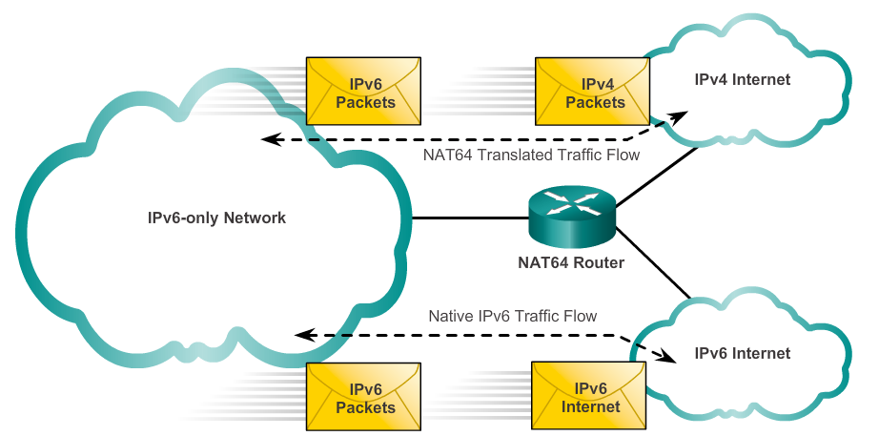
Configuring NAT and IPv6 NAT For IPv6
Notes:
11.1 NAT Operation
11.2.5 Configuring NAT and IPv6
11.2.5.3 NAT For IPv6

Slide 44
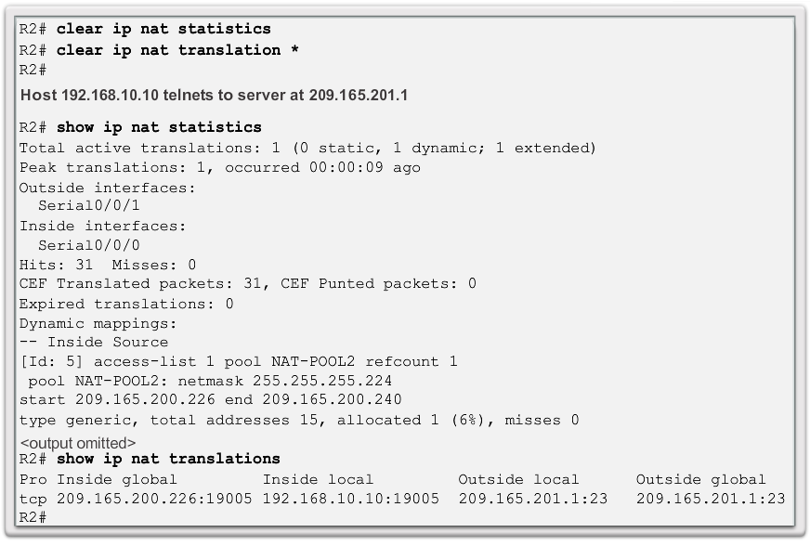
Configuring NAT and IPv6 Troubleshooting NAT: Show commands
Notes:
11.1 NAT Operation
11.3.1 Troubleshooting NAT
11.3.1.1 Troubleshooting NAT: Show commands

Slide 45
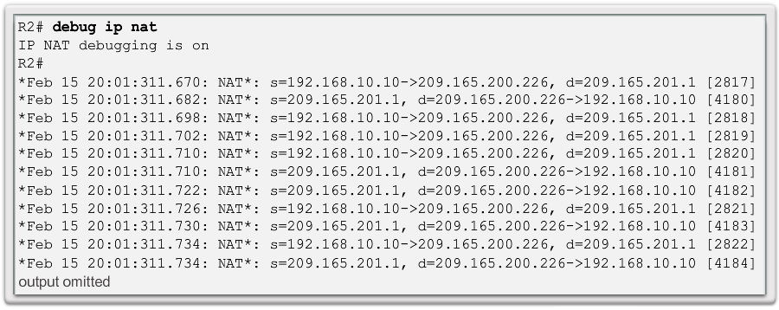
Configuring NAT and IPv6 Troubleshooting NAT: Debug command
Notes:
11.1 NAT Operation
11.3.1 Troubleshooting NAT
11.3.1.2 Troubleshooting NAT: Debug command

Slide 46


